Slide 1
May Nutrition and Health
Teach-In
May 12, 2021
Notes:
Thank you everyone for joining our working group teach-in today.

Slide 2
Agenda
4:00 - 4:10: Defining Nutrition Equity, Tambra Raye Stevenson
4:10 - 4:20: The Nutrition Equity Bill: background and legislation, James Huang
4:20 - 4:30: Themes heard by the FPC about allocations, Kristy McCarron
4:30 - 4:45: Small group discussion
4:45 - 5:00: Instructions on how to testify
Notes:
This is what we’ll be reviewing today.
The FPC has put together an advocacy guide that we will share in teh chat. THis goes into further detail of what we’ll be talking about today.

Slide 3
Housekeeping
The goal of this meeting is to encourage participants to think critically of the proposed legislation, formulate opinions for their own testimony, and provide guidance on how to testify.
Please put all questions in the chat and they will be moderated by FPC members. We will have time for discussion in breakout groups.
For information about how the bill and its allocations came to be, please send us an email and we can send notes from the Community Engagement meeting that was hosted in December.
Notes:
We know that there are a lot fo strong opinions about this bill. So we want to set some housekeeping rules so that we can stay on track.
The goal of this meeting is to encourage participants to think critically of the proposed legislation, formulate opinions for their own testimony, and provide guidance on how to testify.
Please put all questions in the chat and they will be moderated by FPC members. We will have time for discussion in breakout groups.
For information about how the bill and its allocations came to be, please send us an email and we can send notes from the Community Engagement meeting that was hosted in December.

Slide 4
Defining Nutrition Equity
ENSURING EVERYONE can co-create & participate in producing, consuming and learning quality CULTURAL NUTRITIOUS FOOD on their own terms REGARDLESS OF wealth, power and prestige ACROSS THE FOOD SYSTEM.
Unequal nutrition outcomes are rooted in deeper inequities that arise from unjust systems and processes that structure everyday living conditions.
Inequity affects people throughout the social hierarchy and is grounded in the marginalisation, stigmatisation or relative disempowerment of different individuals and groups. As the voices and ideas of marginalised people are unheard or ignored, their health and nutrition needs are not addressed.
Source: Global Nutrition Report 2020

Slide 5
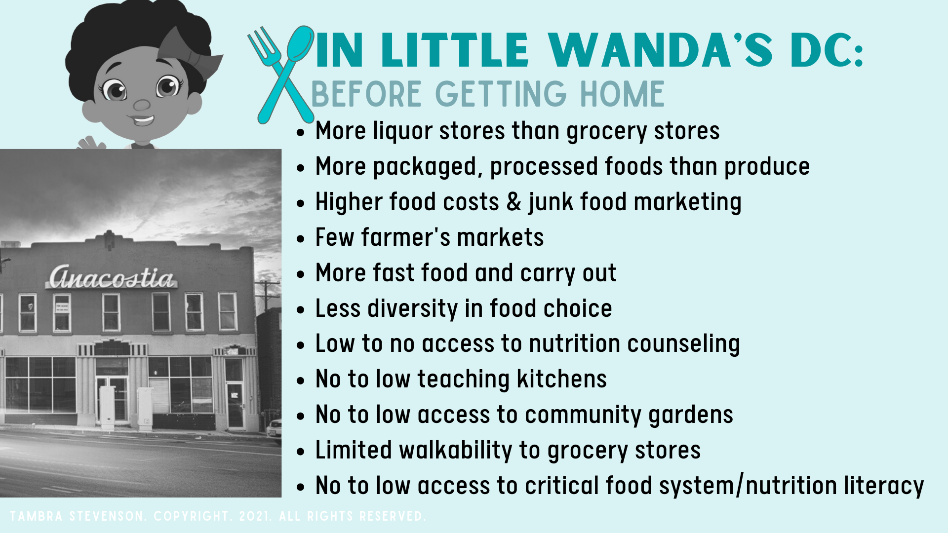

Slide 6
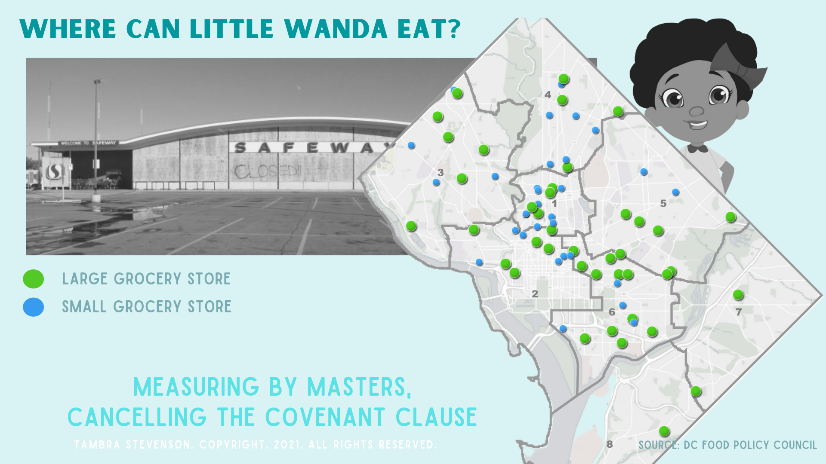

Slide 7
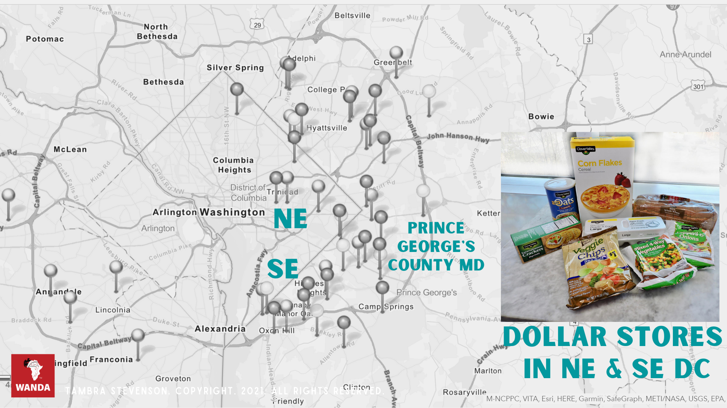

Slide 8
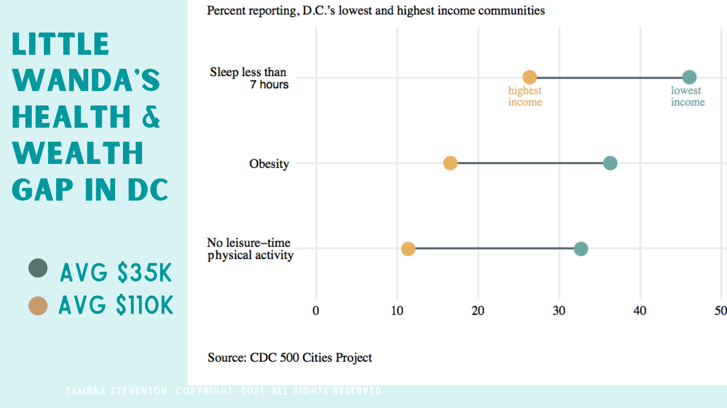

Slide 9
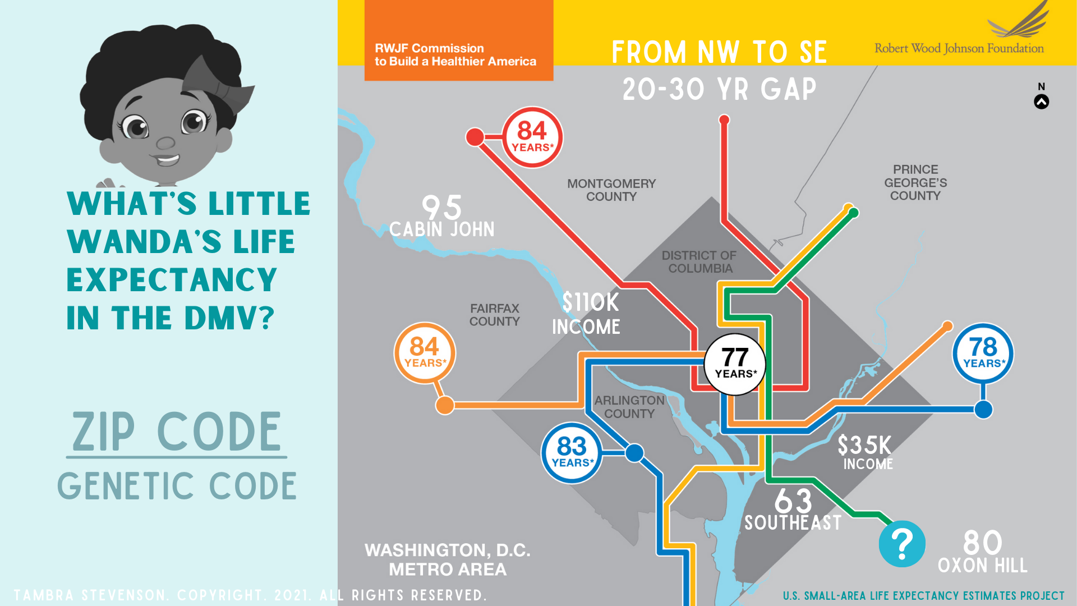

Slide 10
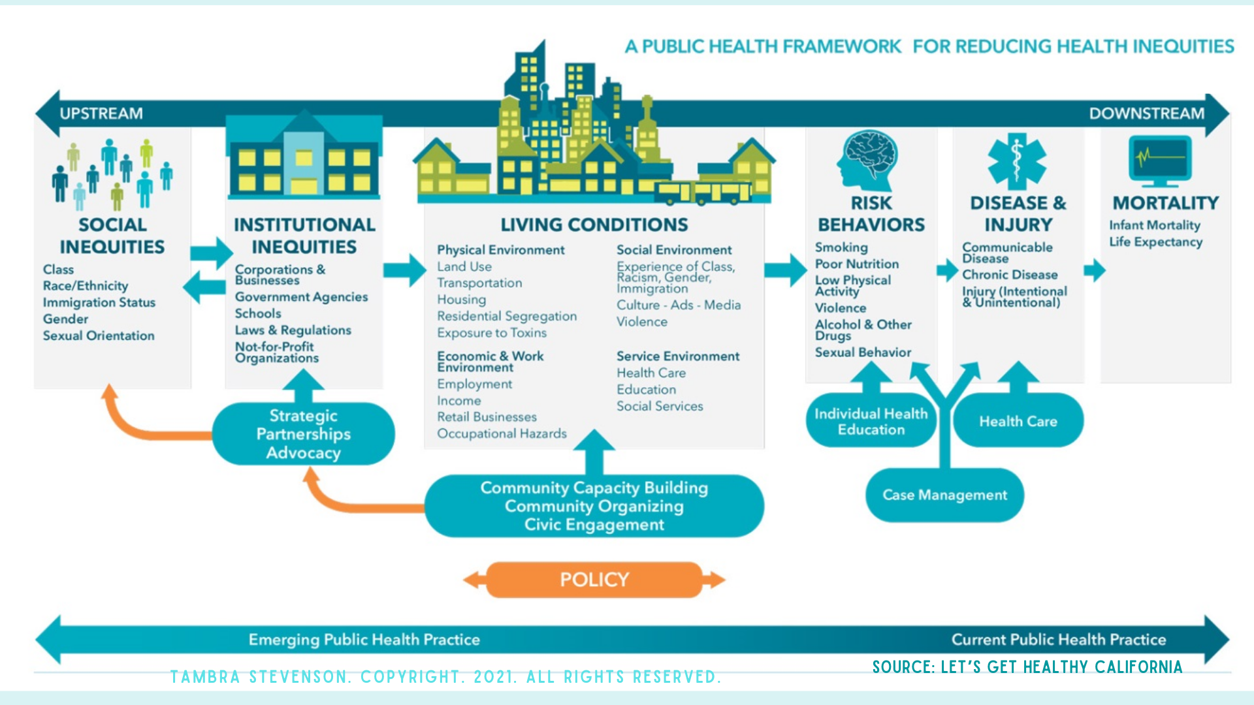

Slide 11


Slide 12


Slide 13


Slide 14
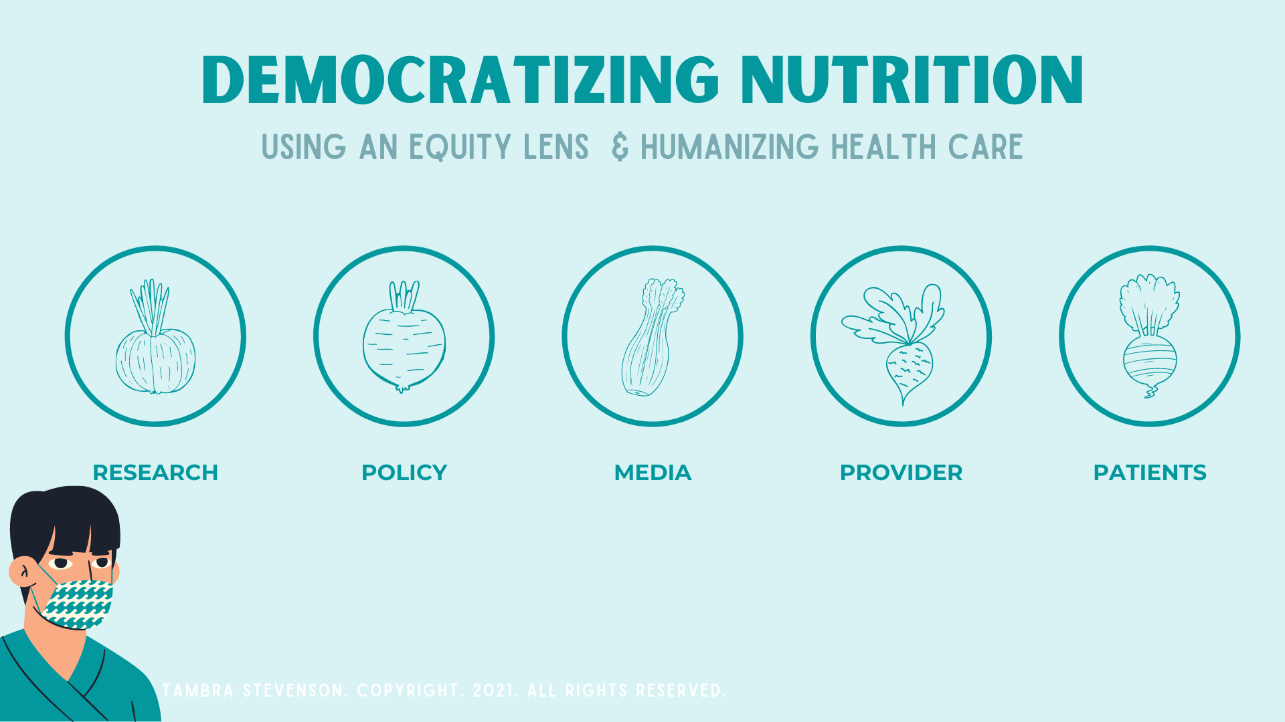

Slide 15
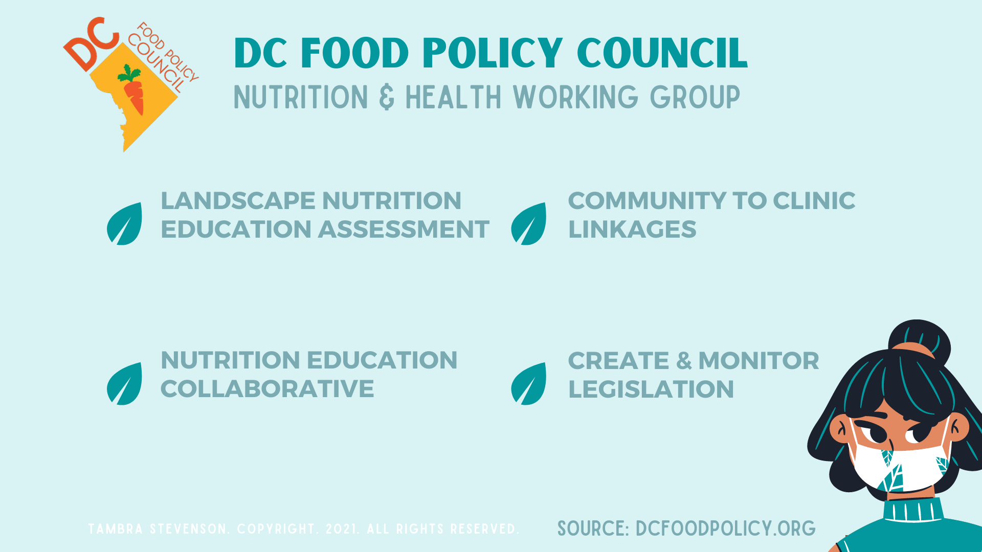

Slide 16
Nutrition Equity Amendment Act of 2021
Notes:
I’m going to now give an overview of the Nutrition Equity Act that was introduced this past month.
The bill was introduced by six council members: Nadeau, Cheh, Bonds, SIlvermen, Allen and Mendelson. .

Slide 17
What does the bill do?
Raises Money | 2. Spends Money | 3. Creates Standards | 4. Gives money to FPC
The bill imposes an excise tax of $0.015 per ounce on the distribution of sugary drinks. | The bill spends funds on several programs, including: nutrition education, Food as Medicine; healthy food access, and local grocery development programs. | The bill creates new requirements for meals served in shelters for those experiencing homelessness, | All remaining revenue shall be deposited into a Fund to be managed by the Food Policy Director.
Notes:
The goals are generally:
To reduce consumption of sugary drinks, which is tied to diet-related chronic diseases like diabetes and heart disease
To raise revenue for local governments, often focused on health, wellness, and early childhood programs
Over the past ten years, many cities in the U.S. have implemented excise taxes on sugary drinks.
Distributors have to pay the excise tax who generally pass the cost onto consumers,
These taxes, which are levied on distributors (and generally raise prices for consumers) can range from $0.01 per ounce to $0.02 per ounce. This raises the “sticker price” / cost of the beverage. SO this happens on the shelf, not at the counter.

Slide 18
2. The allocations of funding (as written).
Amount | Agency | Program
$5,000,000 | DC Dept of Healthcare Finance | For “Food as Medicine” programs: produce Rx, Medically Tailored Meals
$5,000,000 | DC Health | For nutrition-related chronic disease programs: nutrition ed, Diabetes prevention
$1,000,000 | DC Office of the Mayor for Planning and Economic Development (DMPED) | Nourish DC Fund which provides grants, loans, and technical assistance to local food businesses in low food access communities;
$250,000 to the Families First DC Program for nutrition education, cooking lessons, and healthy shopping lessons at Family Success Centers;
Notes:
Funds that are earmarked mean that they need another bill to be passed in order to change them

Slide 19
2. The allocations of funding (as written). CONT’D
Amount | Agency | Program
$250,000 | Families First DC Program | For nutrition education, cooking lessons, and healthy shopping lessons at Family Success Centers There are 10 Family Success Centers (five in Ward 7, five in Ward 8). Each center connects families to prevention services that are critical to family success — from employment and education to food security, childcare, and healthcare, including mental health. Their operating budgets are 4 million/year.
$250,000 | Dept of Health and Human Services | Fornutrition, gardening and physical activity at family shelters and transitional housing
$350,000,000 | Office of State Superintendent of Education (OSSE) | For experiential food literacy education for students in Grades Pre-Kindergarten through 5
 |  | Sufficient funds to cover the funding currently generated by the 8% sales tax on soft drinks; Sufficient funds for any staffing required to implement the legislation;

Slide 20
Themes from FPC Discussions
Notes:
The FPC has held several public conversations on the bill, including last month’s public meeting.
Specifically, this working group held several discussions, given that achieving nutrition equity is central to their collective work. Through these conversations, we identified several themes that we heard from participants about how to allocate the funds. .

Slide 21
Themes heard
Invest in community wealth building and infrastructure
Directly address systemic racism
Allow ongoing community engagement for allocation of funds.

Slide 22
What we asked and what we heard
Question 1: How do you define nutrition equity in Washington DC?
Food Access: 15
BIPOC equity: 2
Nutrition Education: 2
Systems enhancement: 2
Clinical integration: 1
Notes:
To do this, we asked our group two questions, and these are the responses
As a reminder, the Nutrition and health WG attracts food and nutrition educators, dietitians, physicians, public health professionals, and community health workers through the Nutrition and Health Working Group.

Slide 23
What we asked and what we heard
Question 2: Often a bill is significantly marked up after testimonies. Using the equity framework you identified in the previous slide - how can this bill be enhanced? What are your recommendations for markup? (Note that it is projected to generate $20-$25 million dollars in the first few years).
Food Access: 12
Anti-racism training and pipelines: 4
Clinical integration: 4
Reparations: 3
Enhancing nutrition education: 3
Enhancing federal programs (vouchers, childcare, systems alignment): 3
Food Entrepreneurship: 1
General bill recommendations (how to implement rather than funding allocation): 5
Notes:
And then we asked about allocations. We said..
And the number of responses that match each theme.

Slide 24
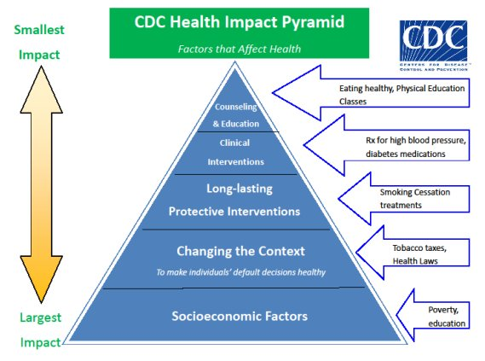
Investing in community wealth and infrastructure
Require MOST amount of individual will power
Require LEAST amount of individual will power
Notes:
And so what do these themes mean?
Therefore, you’ll see on the advocacy guide these three themes for allocation of funds.

Slide 25
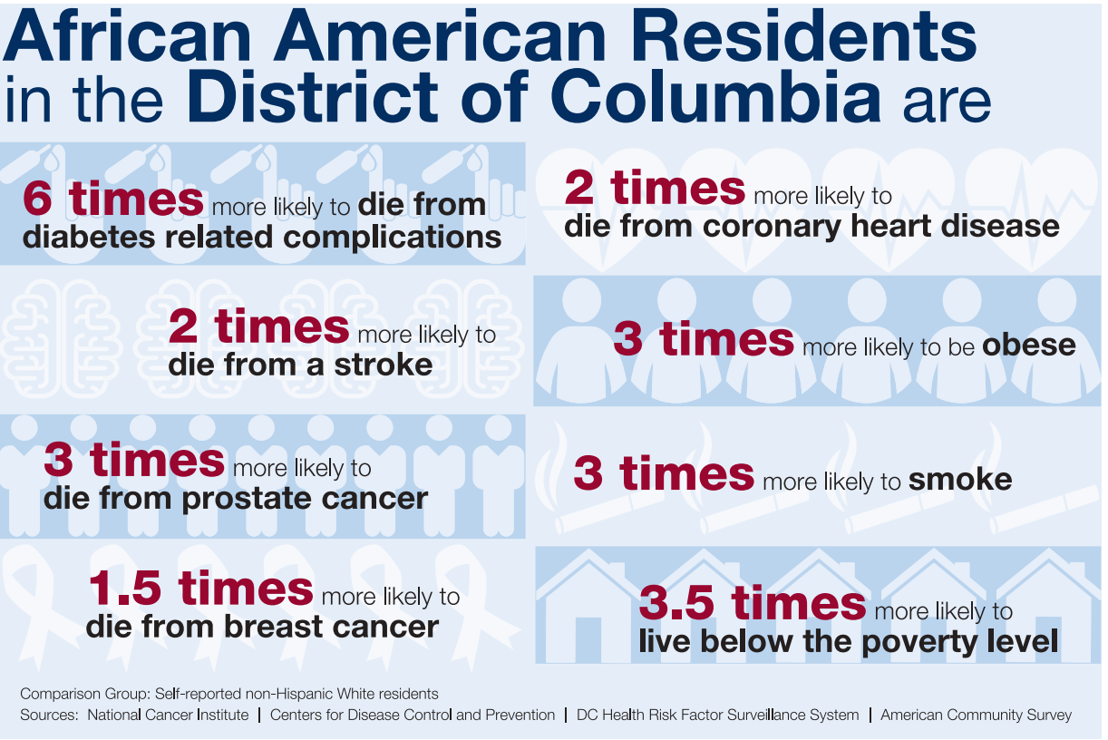
Directly addressing systemic racism
Notes:
The second theme we heard was to directly address systemic racism.
The CDC has named racism as a “serious threat to the public’s health. The systemic inequities of the social determinants of health, one’s access to housing, education, wealth, and employment, place communities of color at greater risk for poor health outcomes.
We know this to be true in the District, where Black residents are 6 times more likely to die from diabetes-related complications and 3.5 times more likely to live below the poverty level.¹⁴
Allocations such as workforce development and tuition assistance for Black and Latinx residents would more directly address systemic racism and the resultant racial wealth gap.

Slide 26

Allowing on-going community engagement for allocation of funds
Permanent earmarking of the funds prevents the use of the funds for evolving community-led projects and priorities over time.
Notes:
As seen during the COVID-19 public health emergency, community food priorities can pivot quickly and it is important to be nimble.
In Berkeley, Seattle, and Navajo Nation, on-going community engagement after the bill has passed has helped to ensure that the funds go towards community-defined prioritie

Slide 27
Regressivity
The regressive nature of this tax disproportionately impacts communities of color because a larger percentage of their income will pay for the increased cost of SSB. (whereas a progressive tax takes a larger percentage from high-income earners)
As such, many local jurisdictions have prioritized reinvesting the tax revenue back into low-income Black and Latinx communities.
Examples of allocations:
Navajo Nation: the revenue is distributed back to the tribe’s local chapters for use in nutrition education and health programs
Philadelphia, PA: and investments universal pre-K programs
San Francisco, CA and Philadelphia, PA: investments in parks and recreation centers to encourage active lifestyles
Albany CA and Berkeley CA: healthy cooking and shopping classes

Slide 28
Breakout groups

Slide 29
Discussion questions
What do you believe are the pros and cons of the Nutrition Equity Bill?
How do you feel about testifying (for or against)?
What’s a reason you would testify?
What’s a reason you wouldn’t testify?

Slide 30
How to testify

Slide 31
How to testify
Register: Anyone wishing to testify should complete the form at https://www.brianneknadeau.com/testify by the end of the business day by THIS FRIDAY.
Create your testimony using the guidance on the FPC guide and lessons learned here.
Practice and testify!
As an individual, you will have 3 minutes to speak. If you represent an organization or business, you may have up to 5 minutes. Your written testimony can be as long as you like.
Remember that one page of double-spaced text (about 250 words) takes about 2 minutes to read aloud!
Anticipate follow-up questions.

Slide 32
Thank you!
Be in touch!
Dr.JamesLHuang@gmail.com
tambra@nativsol.com
Kristy.McCarron@ymcadc.org

